Slide 1
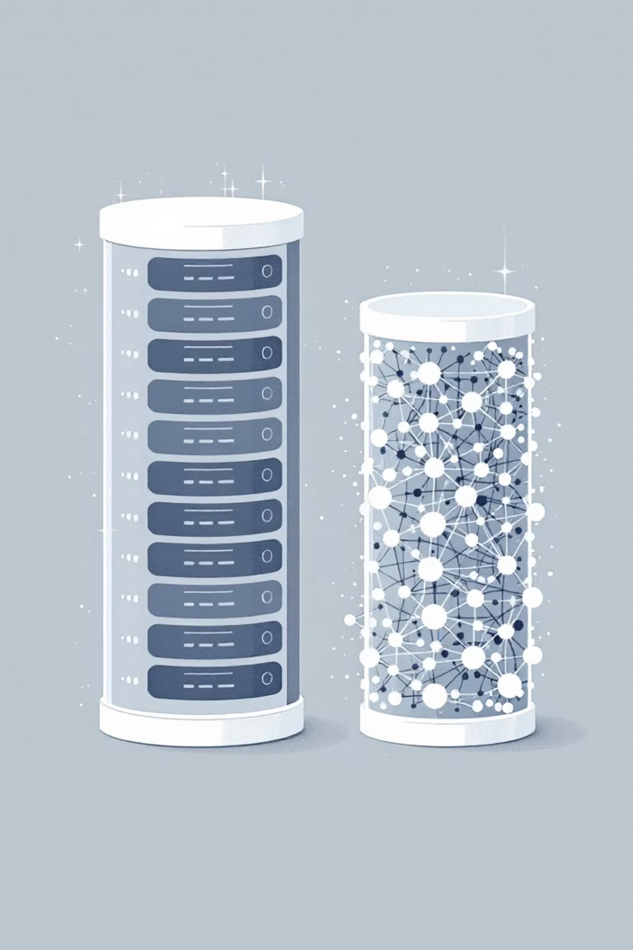

The Shift from Traditional to Gen AI Databases
Generative AI applications require a fundamentally different approach to storing and retrieving data compared to traditional applications. This presentation explores why vector embeddings are crucial and what factors to consider when choosing a Gen AI database.
Processed by PPT Studio
Notes:
Could not generate speaker notes: 429 You exceeded your current quota, please check your plan and billing details. For more information on this error, head to: https://ai.google.dev/gemini-api/docs/rate-limits. [violations {
quota_metric: "generativelanguage.googleapis.com/generate_content_free_tier_requests"
quota_id: "GenerateRequestsPerDayPerProjectPerModel-FreeTier"
quota_dimensions {
key: "model"
value: "gemini-1.5-flash"
}
quota_dimensions {
key: "location"
value: "global"
}
quota_value: 50
}
, links {
description: "Learn more about Gemini API quotas"
url: "https://ai.google.dev/gemini-api/docs/rate-limits"
}
, retry_delay {
seconds: 5
}
]

Slide 2

Traditional vs. Gen AI Databases
Traditional Databases
Gen AI Databases
Store structured data in rows and columns
Handle unstructured data (text, images, audio)
Find data by matching exact values
Understand meaning and context
SQL queries for precise matches (e.g., "find all carnivores")
Find semantically similar items
Rely on vector embeddings
Processed by PPT Studio
Notes:
Could not generate speaker notes: 429 You exceeded your current quota, please check your plan and billing details. For more information on this error, head to: https://ai.google.dev/gemini-api/docs/rate-limits. [violations {
quota_metric: "generativelanguage.googleapis.com/generate_content_free_tier_requests"
quota_id: "GenerateRequestsPerDayPerProjectPerModel-FreeTier"
quota_dimensions {
key: "model"
value: "gemini-1.5-flash"
}
quota_dimensions {
key: "location"
value: "global"
}
quota_value: 50
}
, links {
description: "Learn more about Gemini API quotas"
url: "https://ai.google.dev/gemini-api/docs/rate-limits"
}
, retry_delay {
seconds: 4
}
]

Slide 3



What Are Vector Embeddings?
A vector embedding converts unstructured data—like words, sentences, or images—into a list of numbers (a vector) representing its position in a high-dimensional space.
Unstructured Data
Embedding Process
Vector Database
Text, images, audio files
Convert to numerical vectors
Store in high-dimensional space
The key feature: semantically similar items are placed closer together in this space. For example, "lion" and "tiger" vectors would be close, while "car" would be far away.
Processed by PPT Studio
Notes:
Could not generate speaker notes: 429 You exceeded your current quota, please check your plan and billing details. For more information on this error, head to: https://ai.google.dev/gemini-api/docs/rate-limits. [violations {
quota_metric: "generativelanguage.googleapis.com/generate_content_free_tier_requests"
quota_id: "GenerateRequestsPerDayPerProjectPerModel-FreeTier"
quota_dimensions {
key: "model"
value: "gemini-1.5-flash"
}
quota_dimensions {
key: "location"
value: "global"
}
quota_value: 50
}
, links {
description: "Learn more about Gemini API quotas"
url: "https://ai.google.dev/gemini-api/docs/rate-limits"
}
, retry_delay {
seconds: 3
}
]

Slide 4

Semantic Search with Vector Embeddings
Traditional Search
Semantic Search
"Find the animal named 'lion'"
"Find animals similar to a 'lion'"
Exact match required
Returns tigers, leopards, cheetahs
Misses related concepts
Understands relationships
Limited to structured data
Works with unstructured data
Processed by PPT Studio
Notes:
Could not generate speaker notes: 429 You exceeded your current quota, please check your plan and billing details. For more information on this error, head to: https://ai.google.dev/gemini-api/docs/rate-limits. [violations {
quota_metric: "generativelanguage.googleapis.com/generate_content_free_tier_requests"
quota_id: "GenerateRequestsPerDayPerProjectPerModel-FreeTier"
quota_dimensions {
key: "model"
value: "gemini-1.5-flash"
}
quota_dimensions {
key: "location"
value: "global"
}
quota_value: 50
}
, links {
description: "Learn more about Gemini API quotas"
url: "https://ai.google.dev/gemini-api/docs/rate-limits"
}
, retry_delay {
seconds: 2
}
]

Slide 5

Key Factors for Choosing a Gen AI Database
Support for Vector Search
Database must efficiently store vectors and perform fast similarity searches
Examples: AlloyDB, Spanner, and Cloud SQL for PostgreSQL
Integration with AI/ML Platforms
Should connect easily with AI platforms like Google's Vertex AI to simplify creating embeddings and using foundation models
Processed by PPT Studio
Notes:
Could not generate speaker notes: 429 You exceeded your current quota, please check your plan and billing details. For more information on this error, head to: https://ai.google.dev/gemini-api/docs/rate-limits. [violations {
quota_metric: "generativelanguage.googleapis.com/generate_content_free_tier_requests"
quota_id: "GenerateRequestsPerDayPerProjectPerModel-FreeTier"
quota_dimensions {
key: "model"
value: "gemini-1.5-flash"
}
quota_dimensions {
key: "location"
value: "global"
}
quota_value: 50
}
, links {
description: "Learn more about Gemini API quotas"
url: "https://ai.google.dev/gemini-api/docs/rate-limits"
}
, retry_delay {
seconds: 1
}
]

Slide 6



Scale and Performance
Gen AI deals with enormous datasets and requires rapid responses.
AlloyDB
Spanner
Memorystore
Extremely fast queries (transactional, vector, and analytical)
Scales almost infinitely to handle global traffic and massive datasets, ideal for large language models
In-memory storage for caching, offering fastest possible data access for frequently used information
Processed by PPT Studio
Notes:
Could not generate speaker notes: 429 You exceeded your current quota, please check your plan and billing details. For more information on this error, head to: https://ai.google.dev/gemini-api/docs/rate-limits. [violations {
quota_metric: "generativelanguage.googleapis.com/generate_content_free_tier_requests"
quota_id: "GenerateRequestsPerDayPerProjectPerModel-FreeTier"
quota_dimensions {
key: "model"
value: "gemini-1.5-flash"
}
quota_dimensions {
key: "location"
value: "global"
}
quota_value: 50
}
, links {
description: "Learn more about Gemini API quotas"
url: "https://ai.google.dev/gemini-api/docs/rate-limits"
}
, retry_delay {
seconds: 1
}
]

Slide 7

Data Flexibility
Gen AI applications often use diverse data types:
BigQuery
Best for analyzing petabyte-scale structured and semi-structured datasets
Firestore
Great for flexible, document-style data (unstructured or semi-structured) requiring real-time updates
Processed by PPT Studio
Notes:
Could not generate speaker notes: 429 You exceeded your current quota, please check your plan and billing details. For more information on this error, head to: https://ai.google.dev/gemini-api/docs/rate-limits. [violations {
quota_metric: "generativelanguage.googleapis.com/generate_content_free_tier_requests"
quota_id: "GenerateRequestsPerDayPerProjectPerModel-FreeTier"
quota_dimensions {
key: "model"
value: "gemini-1.5-flash"
}
quota_dimensions {
key: "location"
value: "global"
}
quota_value: 50
}
, links {
description: "Learn more about Gemini API quotas"
url: "https://ai.google.dev/gemini-api/docs/rate-limits"
}
, retry_delay {
}
]

Slide 8


Cost and Operational Efficiency
Storing huge amounts of data can be expensive.
Fully-managed databases like AlloyDB and Cloud SQL reduce the need for manual administration, which lowers operational costs.
When choosing a Gen AI database, consider both direct storage costs and the hidden costs of administration and maintenance.
Processed by PPT Studio
Notes:
Could not generate speaker notes: 429 You exceeded your current quota, please check your plan and billing details. For more information on this error, head to: https://ai.google.dev/gemini-api/docs/rate-limits. [violations {
quota_metric: "generativelanguage.googleapis.com/generate_content_free_tier_requests"
quota_id: "GenerateRequestsPerDayPerProjectPerModel-FreeTier"
quota_dimensions {
key: "model"
value: "gemini-1.5-flash"
}
quota_dimensions {
key: "location"
value: "global"
}
quota_value: 50
}
, links {
description: "Learn more about Gemini API quotas"
url: "https://ai.google.dev/gemini-api/docs/rate-limits"
}
, retry_delay {
seconds: 59
}
]

Slide 9

Security and Data Protection
Encryption
Access Control
Advanced Security
Databases like AlloyDB, Cloud SQL, Spanner, and Firestore automatically encrypt data both at rest and in transit
Integration with IAM (Identity and Access Management) lets you control exactly who can see or modify data
AlloyDB provides extra features like model endpoint management to protect your application from malicious attacks
Processed by PPT Studio
Notes:
Could not generate speaker notes: 429 You exceeded your current quota, please check your plan and billing details. For more information on this error, head to: https://ai.google.dev/gemini-api/docs/rate-limits. [violations {
quota_metric: "generativelanguage.googleapis.com/generate_content_free_tier_requests"
quota_id: "GenerateRequestsPerDayPerProjectPerModel-FreeTier"
quota_dimensions {
key: "model"
value: "gemini-1.5-flash"
}
quota_dimensions {
key: "location"
value: "global"
}
quota_value: 50
}
, links {
description: "Learn more about Gemini API quotas"
url: "https://ai.google.dev/gemini-api/docs/rate-limits"
}
, retry_delay {
seconds: 58
}
]

Slide 10
Key Takeaways
Different Needs, Different Solutions
Choose the Right Database
Vector Embeddings Are Essential
Consider vector search support, AI integration, scale, flexibility, cost, and security
AlloyDB, Spanner, BigQuery, and Firestore each excel in different Gen AI scenarios
They enable semantic search and understanding of unstructured data
The shift to Gen AI databases represents a fundamental change in how we store, retrieve, and understand data.
Processed by PPT Studio
Notes:
Could not generate speaker notes: 429 You exceeded your current quota, please check your plan and billing details. For more information on this error, head to: https://ai.google.dev/gemini-api/docs/rate-limits. [violations {
quota_metric: "generativelanguage.googleapis.com/generate_content_free_tier_requests"
quota_id: "GenerateRequestsPerDayPerProjectPerModel-FreeTier"
quota_dimensions {
key: "model"
value: "gemini-1.5-flash"
}
quota_dimensions {
key: "location"
value: "global"
}
quota_value: 50
}
, links {
description: "Learn more about Gemini API quotas"
url: "https://ai.google.dev/gemini-api/docs/rate-limits"
}
, retry_delay {
seconds: 58
}
]

